Slide 1
Agile scrum approach
Why CHADA tech should transition to an agile scrum framework.

Slide 2
Agile scrum Roles
Product owner
Scrum master
Developer team

Slide 3
Product owner role
Responsible for creating value for the client by creating and sorting a product backlog with the client’s most important requirements at the top.
Translates the client’s requests into user stories that are sorted into the backlog for developers to implement.
Must gather input from all stakeholders involved in the project to manage the team and project efficiently.

Slide 4
Scrum master role
Responsible for facilitating the implementation of the agile scrum approach within an organization.
Assists the team and external organizations to coordinate work more efficiently with agile scrum methods.
Prioritizes the product backlog with the product owner and coaches team members to maximize performance under agile scrum methods.

Slide 5
Developer team member role
Responsible for creating the application or product in accordance with the user stories in the product backlog at the end of each sprint.
Empowered to make decisions about the approach taken when creating the product as long as it fulfills the requirements of the user stories.
Team members are cross functional and have a wide arrange of skills to cooperate and complete a project.

Slide 6
Agile scrum phases
Product backlog
Sprint planning
Developer team
1-4 week sprint
Sprint review and retrospective

Slide 7
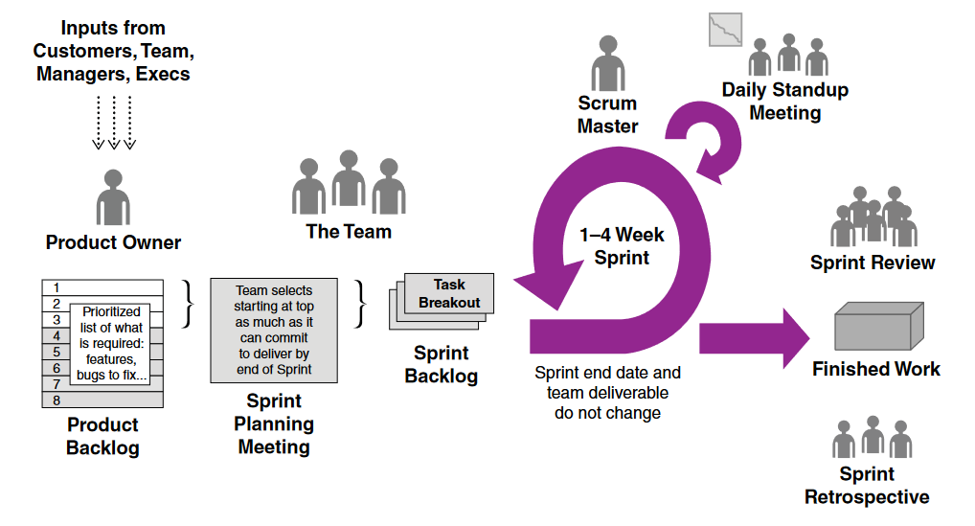
The scrum framework

Slide 8
Product backlog
The product backlog is the list of work to be done by the development team.
Created with inputs from all stakeholders, including team members and clients.
The product owner is responsible for creating and continuously prioritizing user stories in the product backlog to maximize value for the customer, often with help from the scrum master.
Items in the backlog must be small enough to be completed during the 1 to 4 week sprint.

Slide 9
Sprint planning
Meeting that occurs at the beginning of every sprint to decide which stories will be worked on during the next sprint. The product owner, scrum master, and development team are all involved during the negotiation.
The second part of this meeting involves only the development team, and it determines how the developers will split the workload among themselves.

Slide 10
1-4 week sprint
Starts with a short daily standup meeting in which team members coordinate what needs to be done for the day with 3 simple questions:
What did you accomplish yesterday?
What are you going to accomplish today?
What obstacles are in your way?
Often accomplished next to a progress board or tool showing the sprint’s progress and is also updated in real time during the sprint.

Slide 11
Sprint review and retrospective
A sprint review occurs at the end of a sprint when the team demos the functional product and its progress for review and feedback by product owner and other stakeholders.
A sprint retrospective also occurs at the end of a sprint to gather feedback on the development process itself and how to improve upon it for the next sprint.
Both sprint review and retrospective are critical to personalizing the agile scrum framework to work for a company and its environment.

Slide 12
how the process would have been different with a waterfall development approach?
The SNHU Travel project had major features change during its development that would have derailed a traditional waterfall project structure due to the unexpected modifications to the original plan.
Distributing the responsibilities of a project manager among all team members allowed for quick identification and resolution of problems that may have gone unreported or unchanged under a waterfall project manager.
The cost of development is more predictable during a waterfall project, but this comes at the great expense of flexibility and potentially quality.

Slide 13
factors to consider when choosing a waterfall approach or an agile approach
If a project has a lot of uncertainty and not all requirements are strictly defined at the beginning of the project, such as the SNHU Travel project, then an agile approach can adapt to unforeseen changes very efficiently.
However, if a project has little uncertainty and requirements must be rigidly adhered to, such as a rocket launch, then a traditional waterfall approach can be utilized to implement the original plan with few variables along the project execution.

Slide 14
Conclusion
The benefits of the agile approach are clearly advantageous when used under the proper conditions. However, it is not a universal solution to all project types and challenges during product development. The context in which SNHU Travel utilized the agile approach is very similar to the way CHADA TECH conducts business, therefore, the SNHU Travel scenario provides a good reference point and justification for CHADA TECH to make the transition to an agile scrum framework.

Slide 15
references
Charles G. Cobb. (2015). The Project Manager’s Guide to Mastering Agile : Principles and Practices for an Adaptive Approach. Wiley. Accessed December 9, 2021. https://search- ebscohostcom.ezproxy.snhu.edu/login.aspx?direct=true&db=nlebk&AN=937009&site=ehost-live

